Slide 1


Nakui Creary
10-24-2023

Slide 2

Outline
Executive Summary
Introduction
Methodology
Results
Conclusion
Appendix

Slide 3
Executive Summary
Summary of methodologies
1. Data Collection through API
2. Data Collection with Web Scraping
3. Data Wrangling
4. Exploratory Analysis using SQL
5. Exploratory Analysis using Pandas and Matplotlib
6. Interactive Visual Analytics and Dashboard
7. Predictive Analysis
Summary of all results
1. Exploratory analysis results
2. Interactive Analytics
3. Predictive analysis results

Slide 4
Introduction
SpaceX promotes Falcon 9 rocket launches on its website at a price of $62 million, significantly undercutting other providers whose costs can exceed $165 million per launch. The primary source of these savings is SpaceX's ability to recycle the first stage, making it crucial to predict first-stage landings to estimate launch costs and provide valuable data for potential competitors bidding against SpaceX. The project's main objective is to develop a machine learning pipeline for predicting the successful landing of the first stage.
Problems you want to find answers
What are the key factors influencing the successful landing of a rocket?
How do different features interact to affect the success rate of a landing?
What operational conditions must be met to guarantee a successful landing program?

Slide 5

Section 1

Slide 6
Methodology
Executive Summary
Data collection methodology:
Data was collected using SpaceX API and web scraping from Wikipedia
Perform data wrangling
One-hot encoding was applied to categorical features and dropping unnecessary data
Perform exploratory data analysis (EDA) using visualization and SQL
Perform interactive visual analytics using Folium and Plotly Dash
Perform predictive analysis using classification models
Building, tuning, and evaluation of classification models to ensure the best results

Slide 7
Data Collection
The data collection process comprised a dual approach, incorporating API requests from SpaceX's REST API and web scraping to extract data from a table within SpaceX's Wikipedia entry. This combined methodology was essential to gather comprehensive information about the launches, enabling a more in-depth analysis. The data was retrieved via SpaceX REST API which included FlightNumber, Date, BoosterVersion, PayloadMass, Orbit, LaunchSite, Outcome, Flights, GridFins, Reused, Legs, LandingPad, Block, ReusedCount, Serial, Longitude, and Latitude.
The data was collected through Wikipedia web scraping which encompassed Flight No., Launch site, Payload, PayloadMass, Orbit, Customer, Launch outcome, Version Booster, Booster landing, Date, and Time.

Slide 8
Data Collection – SpaceX API
Present your data collection with SpaceX REST calls using key phrases and flowcharts
Add the GitHub URL of the completed SpaceX API calls notebook (must include completed code cell and outcome cell), as an external reference and peer-review purpose
Place your flowchart of SpaceX API calls here

Slide 9
Data Collection - Scraping
Present your web scraping process using key phrases and flowcharts
Add the GitHub URL of the completed web scraping notebook, as an external reference and peer-review purpose
Place your flowchart of web scraping here

Slide 10
Data Wrangling
Our process included exploratory data analysis and the identification of training labels. We also conducted an analysis to count the launches at each site and quantify the number and frequency of different orbits. Additionally, we generated a landing outcome label based on the information in the outcome column and exported the resulting data.

Slide 11
EDA with Data Visualization
The following charts were created:
Flight Number vs. Payload Mass, Flight Number vs. Launch Site, Payload Mass vs. Launch Site, Orbit Type vs. Success Rate, Flight Number vs. Orbit Type, Payload Mass vs. Orbit Type, Success Rate Yearly Trend
Scatter charts prove valuable for examining connections or correlations between two numeric variables.
Bar charts are employed to make comparisons between a numerical value and a categorical variable. The choice between horizontal or vertical bar charts depends on the data's scale and presentation.
Line charts typically display numerical values on both axes and are commonly applied to illustrate how a variable changes over time.

Slide 12
EDA with SQL
The SQL queries performed on the data:
Displaying the names of the unique launch sites in the space mission
Displaying 5 records where launch sites begin with the string ‘CCA’
Displaying the total payload mass carried by boosters launched by NASA (CRS)
Displaying average payload mass carried by booster version F9 v1.1
Listing the date when the first successful landing outcome in ground pad was achieved
Listing the names of the boosters which have success in drone ship and have payload mass greater than 4000 but less than 6000
Listing the total number of successful and failure mission outcomes
Listing the names of the booster versions which have carried the maximum payload mass
Listing the failed landing outcomes in drone ship, their booster versions and launch site names for the months in year 2015
Ranking the count of landing outcomes (such as Failure (drone ship) or Success (ground pad)) between the date 2010-06-04 and 2017-03-20 in descending order

Slide 13
Build an Interactive Map with Folium
The following markers and visual elements were implemented:
Markers for All Launch Sites:
Included markers with circles, popup labels, and text labels for NASA Johnson Space Center, using its latitude and longitude coordinates as the starting location.
Added markers with circles, popup labels, and text labels for all launch sites, showcasing their geographic positions in relation to the Equator and coastlines.
Colored Markers for Launch Outcomes:
Introduced colored markers to distinguish between successful (Green) and failed (Red) launches, utilizing Marker Clusters to highlight launch sites with relatively high success rates.
Distance Indicators between Launch Sites and Their Proximities:
Integrated colored lines to visually represent distances between the launch site KSC LC-39A (for example) and its nearby features such as railways, highways, coastlines, and the closest city.

Slide 14
Build a Dashboard with Plotly Dash
Key additions and features in the project include:
Launch Sites Dropdown List:
Implementation of a dropdown list for easy selection of launch sites.
Pie Chart Displaying Success Launches:
Introduction of a pie chart to depict the overall count of successful launches across all sites.
In the case of a specific launch site selection, the chart showcases the success and failure counts for that site.
Slider for Payload Mass Range:
Inclusion of a slider tool for selecting a specific payload mass range.
Scatter Chart Depicting Payload Mass vs. Success Rate:
Development of a scatter chart that illustrates the relationship between payload mass and success rate, particularly in the context of different booster versions.

Slide 15
Predictive Analysis (Classification)
Generating a NumPy array from the "Class" column within the dataset.
Standardizing the data using the StandardScaler, both fitting and transforming it.
Dividing the data into training and testing sets via the train_test_split function.
Applying GridSearchCV to models such as Logistic Regression, Support Vector Machine (SVM), Decision Tree, and K-Nearest Neighbors (KNN).
Evaluating the accuracy of each model on the test data using the .score() method.
Establishing a GridSearchCV object with cross-validation (cv) set to 10 for the purpose of discovering the best parameters.
Analyzing the confusion matrix for each model.
Determining the best-performing method by examining metrics like the Jaccard score and F1 score.

Slide 16
Results
Exploratory data analysis results
Interactive analytics demo in screenshots
Predictive analysis results

Slide 17

Section 2

Slide 18
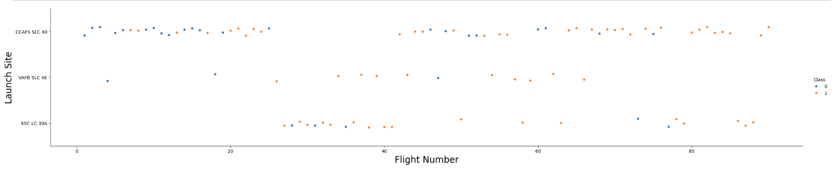
Flight Number vs. Launch Site
Based on the depicted plot, we can observe that the most successful launch site at present is CCAF5 SLC 40, with most recent launches ending successfully. Following closely, VAFB SLC 4E holds the second position, while KSC LC 39A secures the third spot in terms of success rates. Additionally, there is a noticeable overall improvement in the success rate over time.

Slide 19
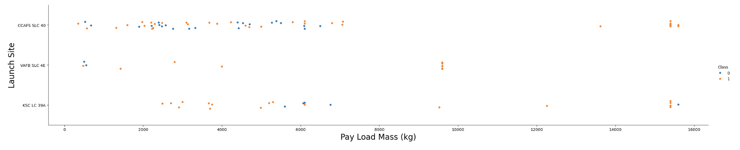
Payload vs. Launch Site
Across all launch sites, a consistent trend is evident: a higher payload mass is associated with a higher success rate. Furthermore, it's notable that most launches with a payload mass exceeding 7000 kg achieved success. Moreover, KSC LC 39A boasts a remarkable 100% success rate for payloads under 5500 kg as well.

Slide 20
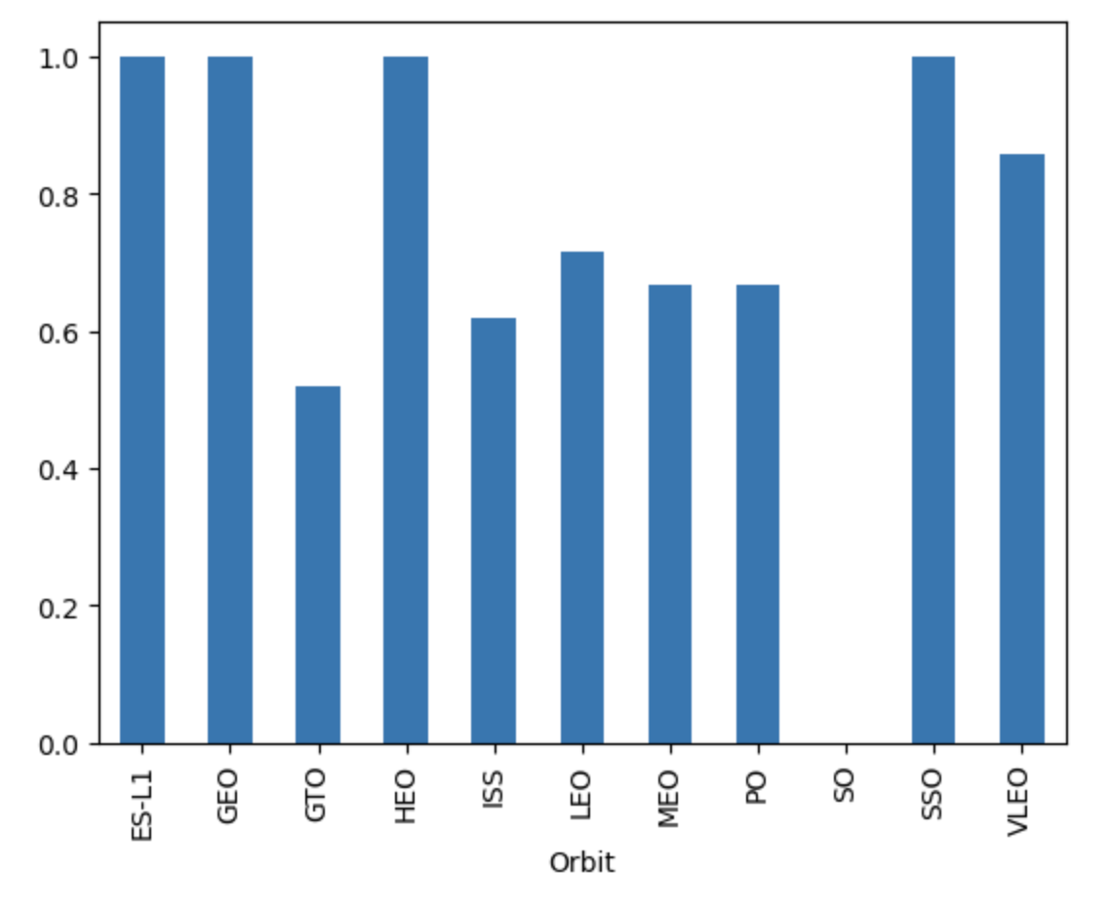
Success Rate vs. Orbit Type
The plot reveals that ES L1, GEO, HEO, SSO, and VLEO exhibit the highest success rates.

Slide 21
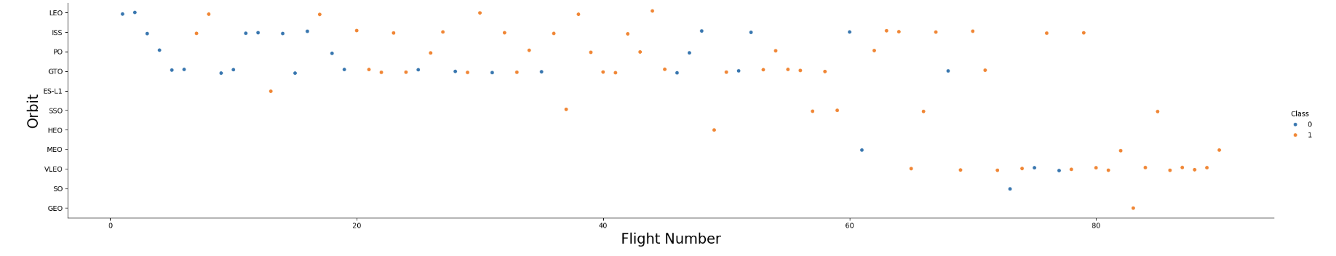
Flight Number vs. Orbit Type
The depicted plot illustrates the relationship between Flight Number and Orbit type. It becomes apparent that, in the LEO orbit, success rates are influenced by the number of flights, while in the GTO orbit, there is no discernible connection between flight number and the orbit's success.

Slide 22
Payload vs. Orbit Type
Show a scatter point of payload vs. orbit type
Show the screenshot of the scatter plot with explanations

Slide 23
Launch Success Yearly Trend
Show a line chart of yearly average success rate
Show the screenshot of the scatter plot with explanations

Slide 24
All Launch Site Names
Find the names of the unique launch sites
Present your query result with a short explanation here

Slide 25
Launch Site Names Begin with 'CCA'
Find 5 records where launch sites begin with `CCA`
Present your query result with a short explanation here

Slide 26
Total Payload Mass
Calculate the total payload carried by boosters from NASA
Present your query result with a short explanation here

Slide 27
Average Payload Mass by F9 v1.1
Calculate the average payload mass carried by booster version F9 v1.1
Present your query result with a short explanation here

Slide 28
First Successful Ground Landing Date
Find the dates of the first successful landing outcome on ground pad
Present your query result with a short explanation here

Slide 29
Successful Drone Ship Landing with Payload between 4000 and 6000
List the names of boosters which have successfully landed on drone ship and had payload mass greater than 4000 but less than 6000
Present your query result with a short explanation here

Slide 30
Total Number of Successful and Failure Mission Outcomes
Calculate the total number of successful and failure mission outcomes
Present your query result with a short explanation here

Slide 31
Boosters Carried Maximum Payload
List the names of the booster which have carried the maximum payload mass
Present your query result with a short explanation here

Slide 32
2015 Launch Records
List the failed landing_outcomes in drone ship, their booster versions, and launch site names for in year 2015
Present your query result with a short explanation here

Slide 33
Rank Landing Outcomes Between 2010-06-04 and 2017-03-20
Rank the count of landing outcomes (such as Failure (drone ship) or Success (ground pad)) between the date 2010-06-04 and 2017-03-20, in descending order
Present your query result with a short explanation here

Slide 34

Section 3

Slide 35
<Folium Map Screenshot 1>
Replace <Folium map screenshot 1> title with an appropriate title
Explore the generated folium map and make a proper screenshot to include all launch sites’ location markers on a global map
Explain the important elements and findings on the screenshot

Slide 36
<Folium Map Screenshot 2>
Replace <Folium map screenshot 2> title with an appropriate title
Explore the folium map and make a proper screenshot to show the color-labeled launch outcomes on the map
Explain the important elements and findings on the screenshot

Slide 37
<Folium Map Screenshot 3>
Replace <Folium map screenshot 3> title with an appropriate title
Explore the generated folium map and show the screenshot of a selected launch site to its proximities such as railway, highway, coastline, with distance calculated and displayed
Explain the important elements and findings on the screenshot

Slide 38

Section 4

Slide 39
<Dashboard Screenshot 1>
Replace <Dashboard screenshot 1> title with an appropriate title
Show the screenshot of launch success count for all sites, in a piechart
Explain the important elements and findings on the screenshot

Slide 40
<Dashboard Screenshot 2>
Replace <Dashboard screenshot 2> title with an appropriate title
Show the screenshot of the piechart for the launch site with highest launch success ratio
Explain the important elements and findings on the screenshot

Slide 41
<Dashboard Screenshot 3>
Replace <Dashboard screenshot 3> title with an appropriate title
Show screenshots of Payload vs. Launch Outcome scatter plot for all sites, with different payload selected in the range slider
Explain the important elements and findings on the screenshot, such as which payload range or booster version have the largest success rate, etc.

Slide 42

Section 5

Slide 43
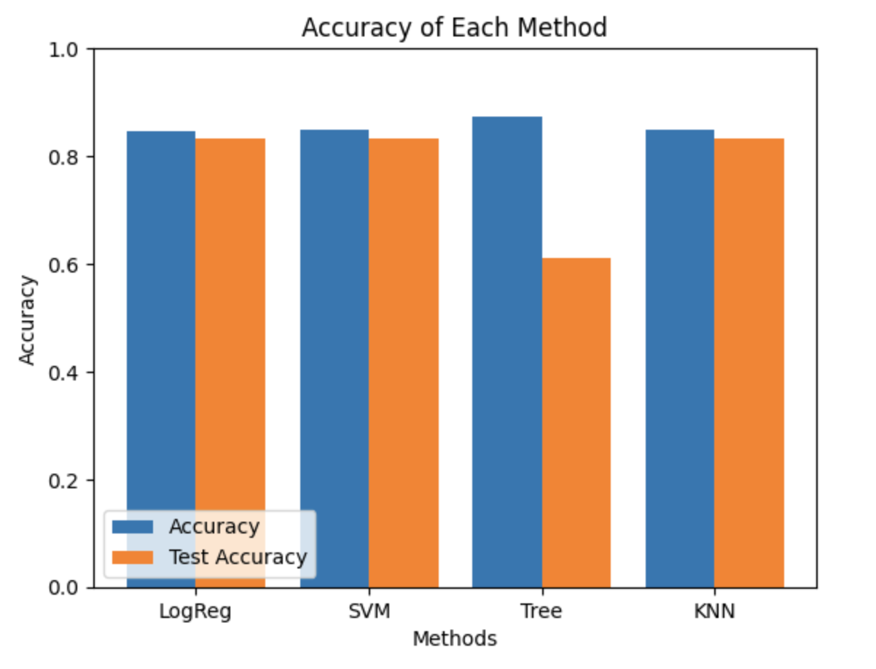
Classification Accuracy
The decision tree classifier boasts the highest accuracy among the models.

Slide 44
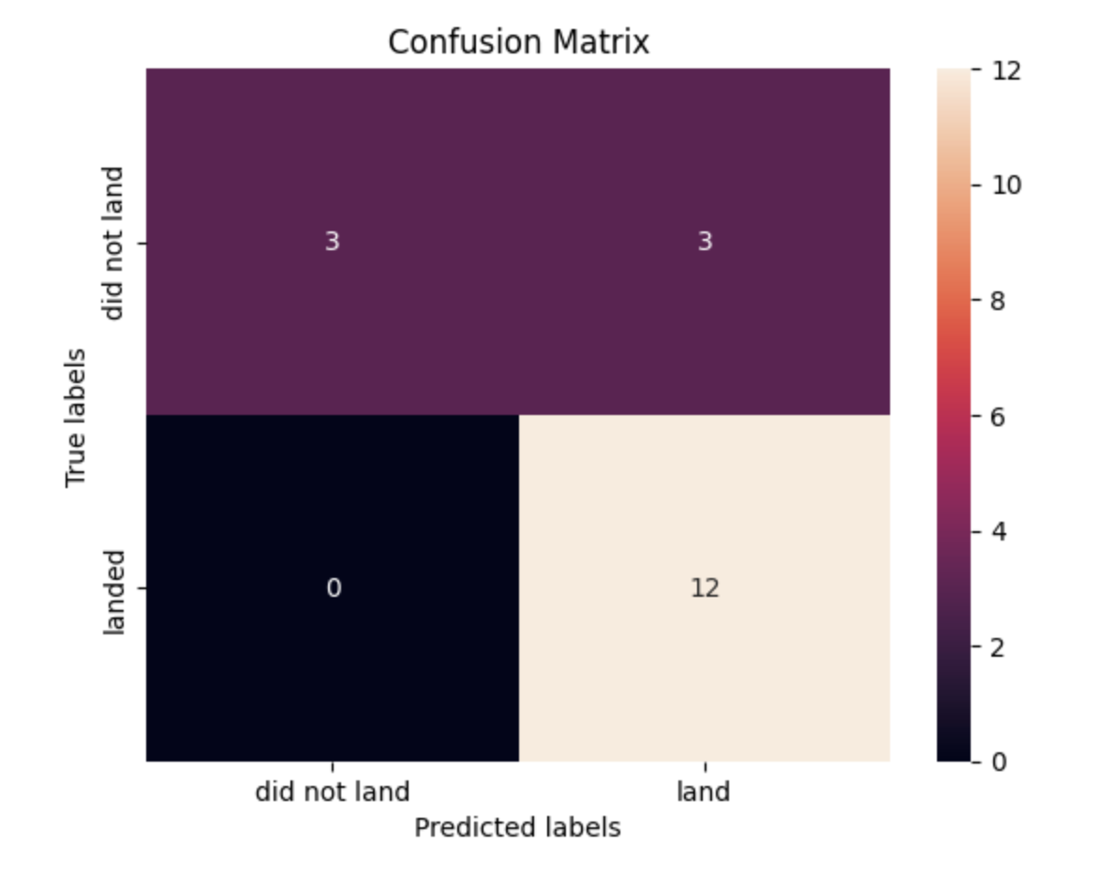
Confusion Matrix
The confusion matrix associated with the decision tree classifier clearly demonstrates the model's ability to differentiate between distinct classes. The primary challenge arises from the occurrence of false positives, where unsuccessful landings are incorrectly classified as successful landings by the classifier.

Slide 45
Conclusions
Based on the data analysis, we can conclude that:
The Decision Tree is the best machine learning algorithm for this data
Launch success rate stated to increase in 2013 to 2020
Orbits ES-L1, GEO, HEO, SSO, VLEO had the most success rate
KSC LC-39A had the highest success rate of the launches from all the sites
Launches with a smaller payload mass provided better results than launches with larger payload mass

Slide 46
Appendix
Include any relevant assets like Python code snippets, SQL queries, charts, Notebook outputs, or data sets that you may have created during this project

Slide 47


